Slide 1

Unit 4 : Types of machine learning
Lecture 1: Introduction to Machine Learning Techniques
School of Computer Science UPES, Dehradun
India

Slide 2
Table of Contents
Introduction to machine learning
Types of ML
Classification in supervised machine
Regression in supervised machine learning
Types of ML
Machine Learning Life cycle
Applications of Machine Learning
Benefits of Machine Learning

Slide 3
Learning & Course Outcomes
LO1: Understand and explain the basic concepts and terminology of machine learning, including supervised learning, unsupervised learning, reinforcement learning, features, labels, and datasets.
LO2: Differentiate between various types of machine learning algorithms (e.g., classification, regression, clustering, and dimensionality reduction) and identify appropriate use cases for each.
LO3:Understand the theoretical foundations of common machine learning algorithms.
CO1: Understand the basic concepts and techniques of Artificial Intelligence.
CO2: Understand the basics of Machine Learning and its types.

Slide 4
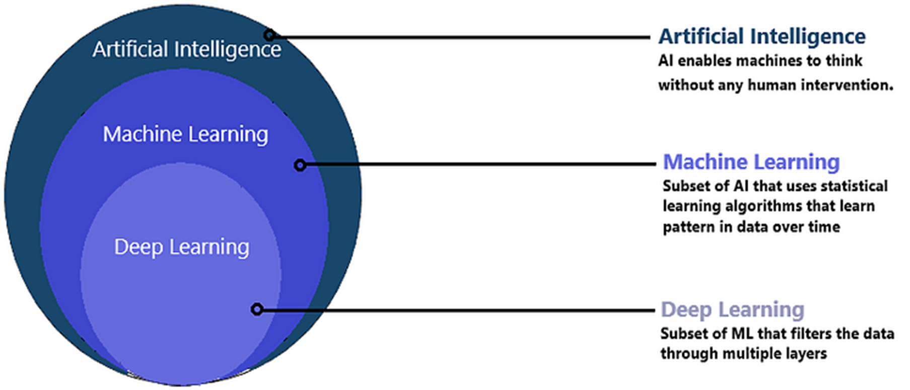
Machine Learning
Artificial Intelligence is purely math and scientific exercise but when it becomes computational, it starts to solve human problems.
Machine Learning is a subset of Artificial Intelligence.
Figure: 1

Slide 5
Machine Learning
The term machine learning was first coined in the 1950s when Artificial Intelligence pioneer Arthur Samuel built the first self-learning system for playing checkers.
ML involves the development of algorithms and statistical models that enable computers to improve their performance in tasks through experience.
ML explores the study and construction of algorithms that can learn from data and make predictions on data.
Based on more data, machine learning can change actions and responses which will make it more efficient, adaptable, and scalable.

Slide 6
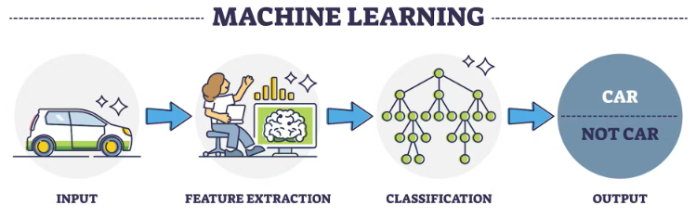
Machine Learning
ML algorithms are able to detect patterns in data and learn from them, in order to make their own predictions. In short, ML algorithms and models learn through experience.
Today, ML is everywhere ‒ automated translation, image recognition, voice search technology, self-driving cars, and beyond.
Figure: 2

Slide 7
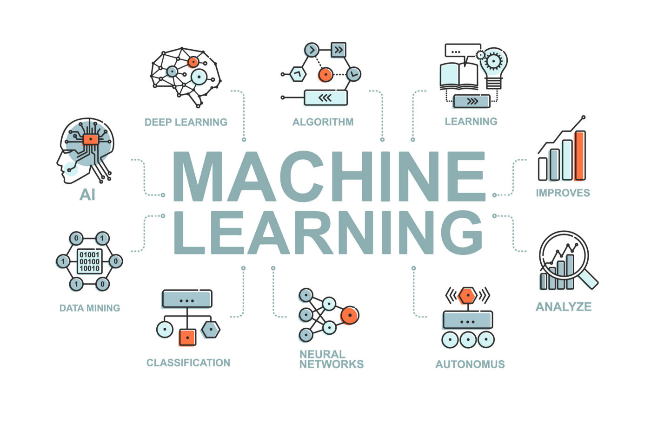
Machine Learning
Figure: 3

Slide 8
Machine Learning
Deep Learning is a technique for implementing machine learning algorithms.
It uses Artificial Neural Networks for training data to achieve highly promising decision making.
The neural network performs micro calculations with computational on many layers and can handle tasks like humans.

Slide 9
Machine Learning
In traditional programming, a computer engineer writes a series of directions that instruct a computer how to transform input data into a desired output.
Instructions are mostly based on an IF-THEN structure: when certain conditions are met, the program executes a specific action.
ML is an automated process that enables machines to solve problems with little or no human input, and take actions based on past observations.
While AI and ML are often used interchangeably, they are two different concepts.
AI is the broader concept – machines making decisions, learning new skills, and solving problems in a similar way to humans.
Whereas machine learning is a subset of AI that enables intelligent systems to autonomously learn new things from data.
Machine learning can be put to work on massive amounts of data and can perform much more accurately than humans.

Slide 10
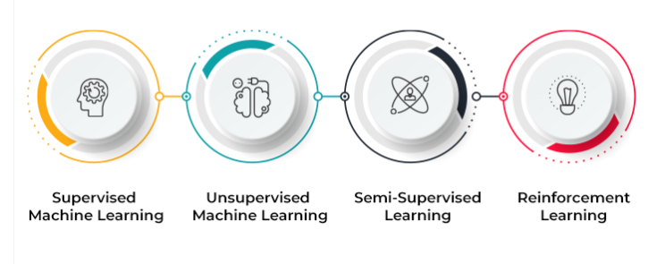
Types of ML
Figure: 5

Slide 11
Types of ML
ML implementations are classified into four major categories, depending on the nature of the learning “signal” or “response” available to a learning system which are as follows:
Supervised learning: training a model on labeled data
Unsupervised learning: training a model on unlabeled data
Reinforcement learning: training a model through trial and error
Semi-supervised learning: falls between unsupervised learning and supervised learning.

Slide 12
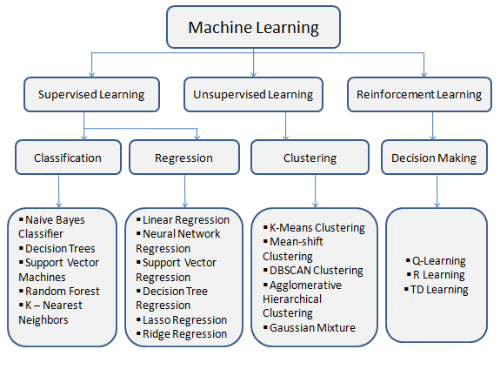
Types of ML

Slide 13
Types of ML
Supervised learning is the ML task of learning a function that maps an input to an output based on example input-output pairs.
The given data is labeled.
Both classification and regression problems are supervised learning problems.
Example — Consider the following data regarding patients entering a clinic . The data consists of the gender and age of the patients and each patient is labeled as “healthy” or “sick”.
Gender | Age | Label
Male | 48 | Healthy
Female | 20 | Sick
Male | 47 | Sick
Female | 50 | Healthy
Female | 55 | Sick
Male | 39 | Sick
Male | 47 | Healthy

Slide 14
Types of ML
A supervised learning algorithm analyzes sample data and makes an inference – basically, an educated guess when determining the labels for unseen data.
This is the most common and popular approach to machine learning.
It’s “supervised” because these models need to be fed manually tagged sample data to learn from.
Data is labeled to tell the machine what patterns (similar words and images, data categories, etc.) it should be looking for and recognize connections with.
For example, if we want to automatically detect spam, we need to feed a machine learning algorithm examples of emails that we want classified as spam and others that are important, and should not be considered spam.
The two types of supervised learning tasks: classification and regression.

Slide 15
Classification in supervised machine
There are a number of classification algorithms used in supervised learning, with Support Vector Machines (SVM) and Naive Bayes among the most common.
In classification tasks, the output value is a category with a finite number of options.
For example, in a pre-trained sentiment analysis model, we can automatically classify data as positive, negative, or neutral.
Regression in supervised machine learning
In regression tasks, the expected result is a continuous number.
This model is used to predict quantities, such as the probability an event will happen, meaning the output may have any number value within a certain range.
Predicting the value of a property in a specific neighborhood or the spread of COVID19 in a particular region are examples of regression problems.

Slide 16
Types of Classification Algorithms
Naive Bayes classifier
Decision Trees
Logistic Regression
K-Nearest Neighbours
Support vector machine
Random forest classification
Types of Regression Algorithms
Simple linear Regression
Multiple linear Regression
polynomial Regression
Decision Tree Regression
Random forest Regression
Ensemble Method

Slide 17
Types of ML
Unsupervised learning is a type of machine learning algorithm used to draw inferences from datasets consisting of input data without labeled responses.
In unsupervised learning algorithms, classification or categorization is not included in the observations.
Example: Consider the following data regarding patients entering a clinic. The data consists of the gender and age of the patients.
Gender | Age
Male | 48
Female | 20
Male | 47
Female | 50
Female | 55
Male | 39
Male | 47

Slide 18
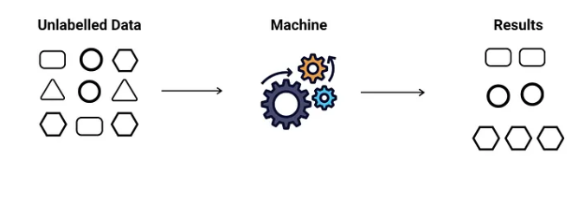
Types of ML
As a kind of learning, it resembles the methods humans use to figure out that certain objects or events are from the same class, such as by observing the degree of similarity between objects.
Some recommendation systems that you find on the web in the form of marketing automation are based on this type of learning.
Types of Unsupervised Learning
Clustering
Anomaly detection
Association
Auto-encoders
Latent variable models
Neural Networks
Figure: 6

Slide 19
Types of ML
Reinforcement learning is the problem of getting an agent to act in the world so as to maximize its rewards.
A learner is not told what actions to take as in most forms of machine learning but instead must discover which actions yield the most reward by trying them.
Example: Consider teaching a dog a new trick: we cannot tell him what to do, what not to do, but we can reward/punish it if it does the right/wrong thing.
When watching the video, notice how the program is initially clumsy and unskilled but steadily improves with training until it becomes a champion.

Slide 20
Types of ML
Semi-supervised learning is an approach to machine learning that combines small labeled data with a large amount of unlabeled data during training.
Where an incomplete training signal is given: a training set with some (often many) of the target outputs missing.
In Semi-supervised learning model uses labeled data as an input to make inferences about the unlabeled data, providing more accurate results than regular supervised-learning models.
There is a special case of this principle known as Transduction where the entire set of problem instances is known at learning time, except that part of the targets are missing.
Semi-supervised learning doesn’t require a large number of labeled data, so it’s faster to set up, more cost-effective than supervised learning methods, and ideal for businesses that receive huge amounts of data.

Slide 21
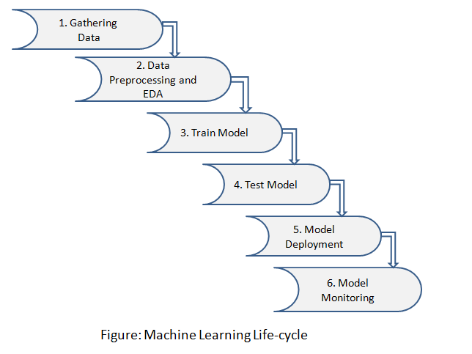
Machine Learning Life cycle
Machine Learning helps to increase the performance and productivity of the task. It includes learning and self-correction when introduced with new data.
Figure: 7

Slide 22
Machine Learning Life cycle
Machine Learning lifecycle involves six major steps:
Step 1: Gathering Data
Identify various data sources such as Kaggle and collect the required dataset
Step 2: Data Preprocessing and EDA
In this step, we do an analysis of the data for missing values, duplicate data, invalid data using different analytical techniques. And also preprocessing the data for feature extractions, feature analysis, and data visualization.
Step 3: Train Model
We use a dataset to train the model using various machine learning algorithms. Training a model is important so that it can understand the various patterns, rules, and features.
Step 4: Test Model
In this step, we check for the accuracy of our model by providing a test dataset to the trained model.

Slide 23
Machine Learning Life cycle
Step 5: Model Deployment
Model deployment means integrating a machine learning model into an existing production environment that takes input and returns output to make business decisions based on data.
Various technologies that you can use to deploy your machine learning models are listed:
Docker
Kubernetes
AWS SageMaker
MLFlow
Azure Machine Learning Service
Step 6: Model Monitoring
After deployment of the model here comes model monitoring which monitors your machine learning models for factors like errors, crashes, and latency and most importantly to ensure that your model is maintaining the desired performance.

Slide 24
Applications of Machine Learning
Real-World Applications of Machine Learning
Automatic Language Translation in Google Translate
Faster route selection in Google Map
Driverless/Self-driving car
Smartphone with face recognition
Speech Recognition
Ads Recommendation System
Netflix Recommendation System
Auto friend tagging suggestion in Facebook
Stock market trading
Fraud Detection
Weather Prediction
Medical Diagnosis
Chatbot
Machine Learning in Agriculture

Slide 25
Benefits of Machine Learning
Benefits of machine learning
Work Automation
Powerful predictive Ability
Increased in sales in the e-commerce market
ML benefits in the medical domain for enhancing medical diagnosis, drug development
Machine Learning is used in robotic medical surgery
ML in finance increases productivity enhances revenue and gives secure transactions
Modeling the data to make useful decisions

Slide 26

Thank You

